Slide 1


SMART INDIA HACKATHON 2026
TITLE PAGE
Problem Statement ID – SIH26027
Problem Statement Title - Al-Powered Automatic Block Planning to Maximize Asset Availability for Train Operations on Indian Railways
Theme - Transportation & Logistics
PS Category - Software
Team Name - ANTIMATTER

Slide 2
RAILSYNC
Synchronizing Maintenance, Maximizing Availability
AntiMatter
RailSync integrates maintenance requirements from TMS, SMMS and TDMS with train timetable, freight forecasts and corridor availability to automatically generate coordinated maintenance block plans.
HOW IT WORKS
UNIFY: Standardize all demands into interval variables
EVALUATE: Auto-exclude infeasible slots via constraint rules
BUNDLE: Merge co-located tasks into Super-Tasks
OPTIMIZE: CP-SAT solves all bundles jointly, optimally
REPLAN: Freeze past, add disruption, re-optimize fast
APPROVE: Planners verify schedule via solver-generated explanations
Unique Value Points
Cross-Department "Super-Tasks" - Auto-bundles Engineering, Signalling, Traction into unified blocks.
Explainable AI (White-Box Scheduling) - Lazy clause generation turns constraint math into readable logic.
Live Timetable Integration - Embeds real GTFS train schedules into the constraint model.
60-Second Disruption Recovery - Dynamic state-injection freezes the past, re-optimizes on the fly.

Slide 3
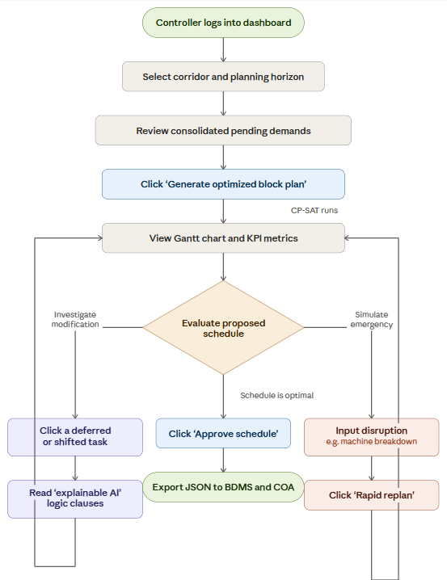
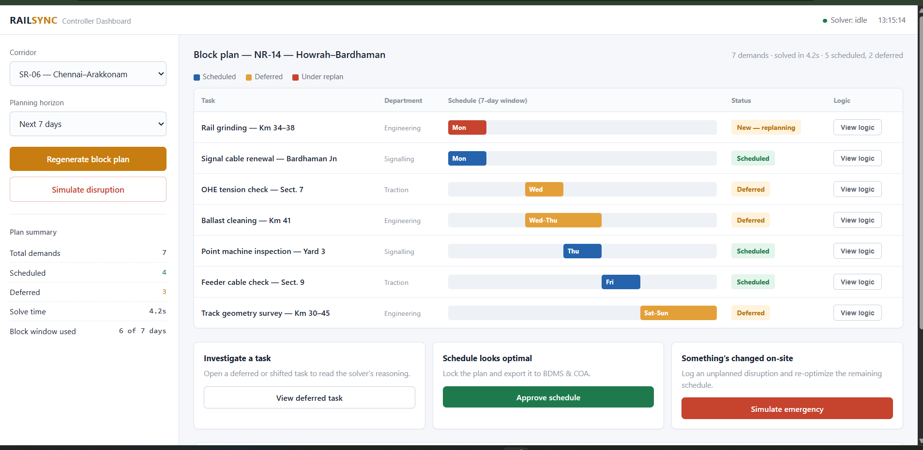
TECHNICAL APPROACH
AntiMatter
Tech Stack
Backend & Optimization
Language: Python
Optimization Engine: Google OR-Tools CP-SAT solver (constraint programming + lazy clause generation)
Data Processing: Pandas, NumPy to standardizing GTFS timetables and multi-department demand data
API Layer: FastAPI wraps the solver as an async REST service
Frontend & Infrastructure
Frontend: React.js for interactive controller dashboard with Gantt-chart views
Compute: Multi-core CPU cloud instances (AWS EC2 Compute-Optimized / GCP N2)
Demo Link

Slide 4
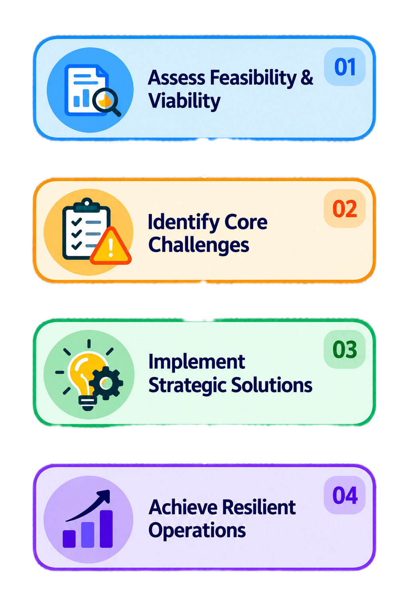
FEASIBILITY AND VIABILITY
AntiMatter
Data Availability –Sourcing inputs from multiple departments
Technical Viability – Scaling the hybrid AI models
Operational Integration – Managing the workforce transition
Feasibility
Unifying heterogeneous data across Engineering, Signalling, and Traction.
Enabling rapid, constraint-aware decisions during dynamic disruptions.
Transitioning operational personnel away from manual workflows.
Maintaining resilient planning against unpredictable network events.
Challenges
Strategies for overcoming the challenges
Unified intelligence layer for cross-departmental coordination.
Hybrid AI for real-time, disruption-aware planning.
Explainable, human-in-the-loop decision support.
Resilient, fail-safe, and adaptive system design.

Slide 5
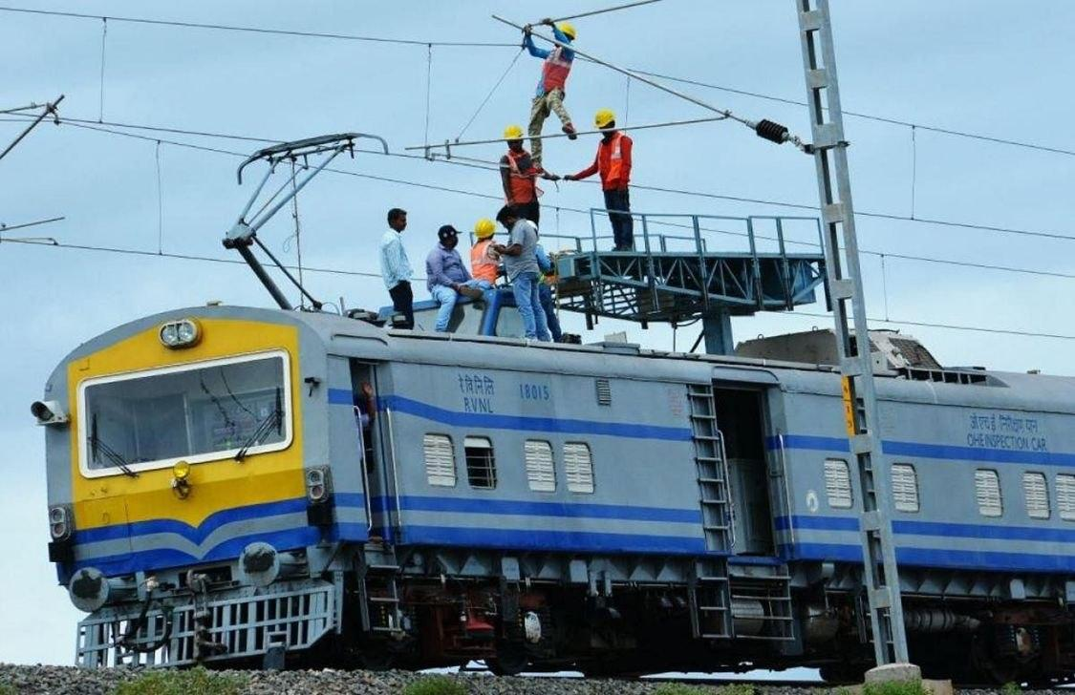
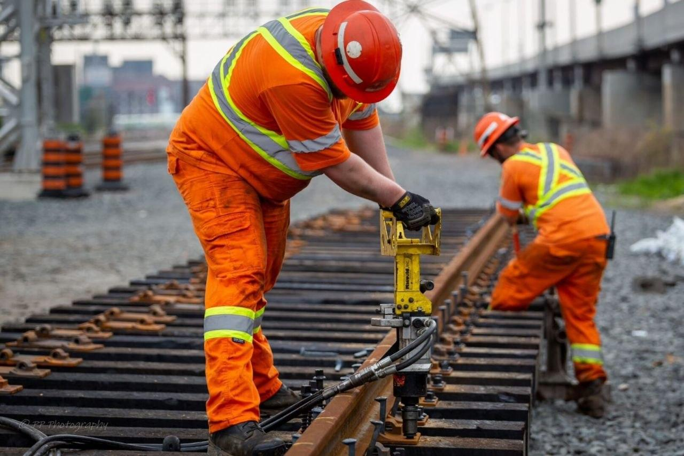
IMPACT AND BENEFITS
AntiMatter
Potential impact on the target audience:
Punctuality: Reduces train delays and cancellations caused by uncoordinated maintenance blocks.
Conflict-Free Scheduling: Unifies data-driven planning across Civil, Signal, and Telecom departments.
Modernization: Directly supports Indian Railways AI-adoption and operational modernization priorities.
Benefits of the Solution
Operational Efficiency: Reduces manual errors and optimizes asset utilization.
Economic Gains: Less downtime increases passenger/freight throughput and revenue.
Rapid Approvals: Cuts cross-departmental coordination from hours to minutes.
Resource Optimization: Frees engineers from manual planning for critical fieldwork.

Slide 6
RESEARCH AND REFERENCES
AntiMatter
IIT Bombay Railway Operations & Timetabling Lab
Research on railway timetabling, capacity utilization, and simulation supports data-driven railway optimization. IIT Bombay Railway Operations Lab
CAG Report No. 22 of 2021 – Indian Railways
Highlights fragmented departmental maintenance and the need for integrated corridor blocks. CAG Audit Report on Indian Railways
Dynamic Railway Rescheduling – D'Ariano et al. (2007)
Demonstrates rapid schedule re-optimization during railway operational disturbances. European Journal of Operational Research Paper
Track Allocation in Indian Railways – Utsav Shukla (2026)
Studies allocation of limited track time between maintenance and train operations. Track Allocation in Indian Railways Study
Track-Time Governance in Indian Railways – Utsav Shukla (2026)
Highlights the need for better coordination between maintenance and railway operations. Corridor Pilot for Track-Time Governance
Prototype based on the given idea - https://youtu.be/spbM263K5fQ

